Slide 1
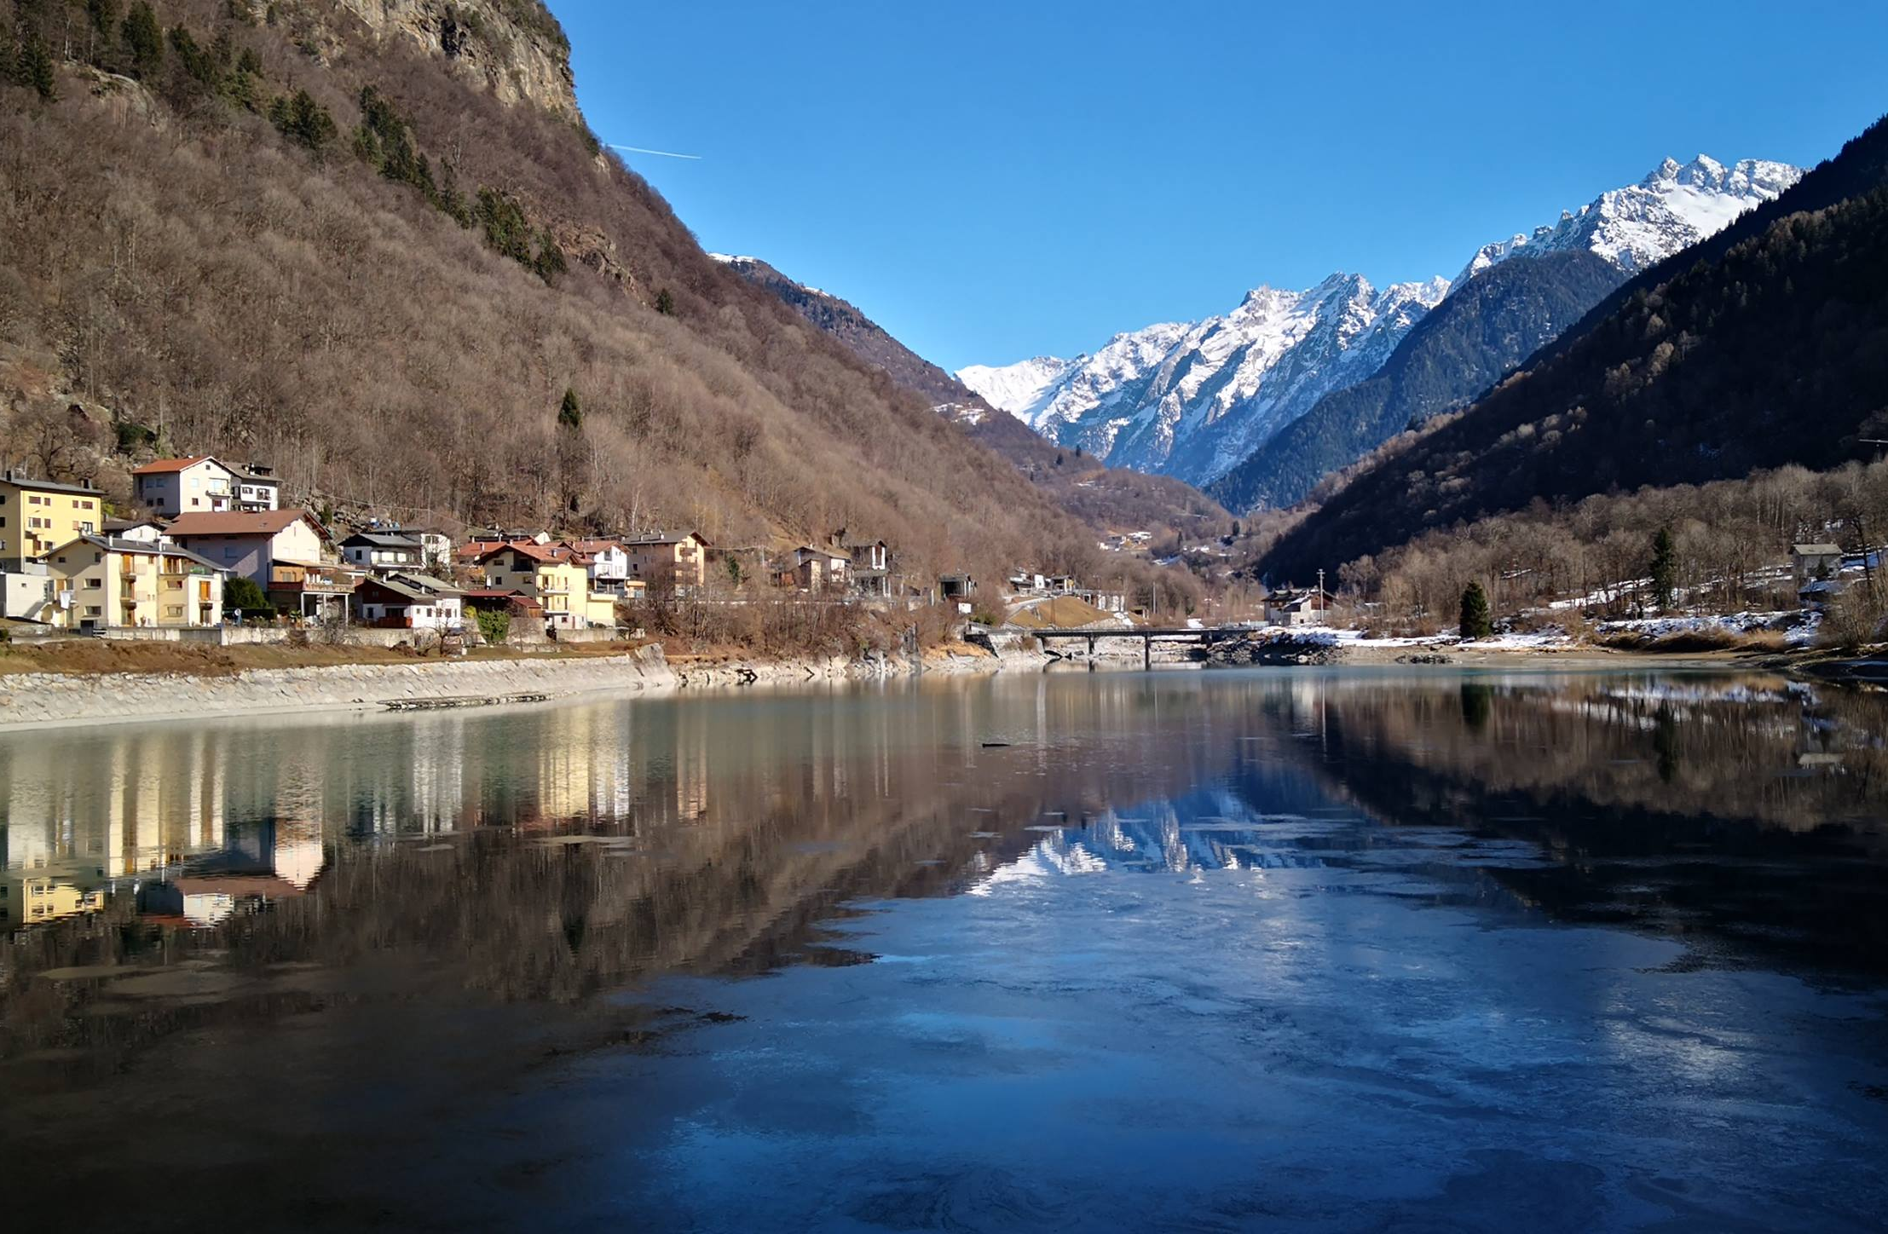
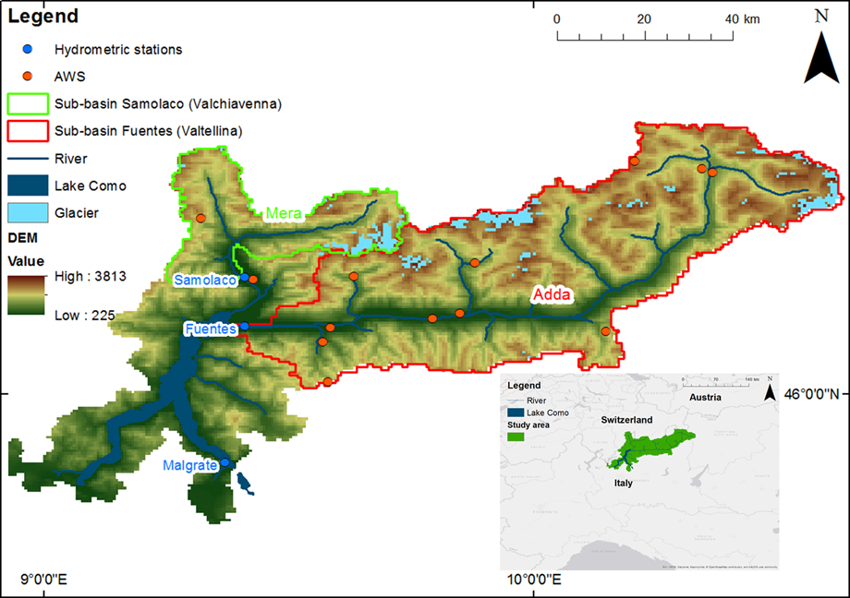
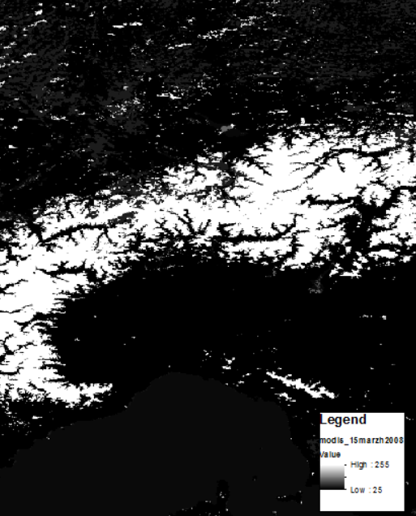
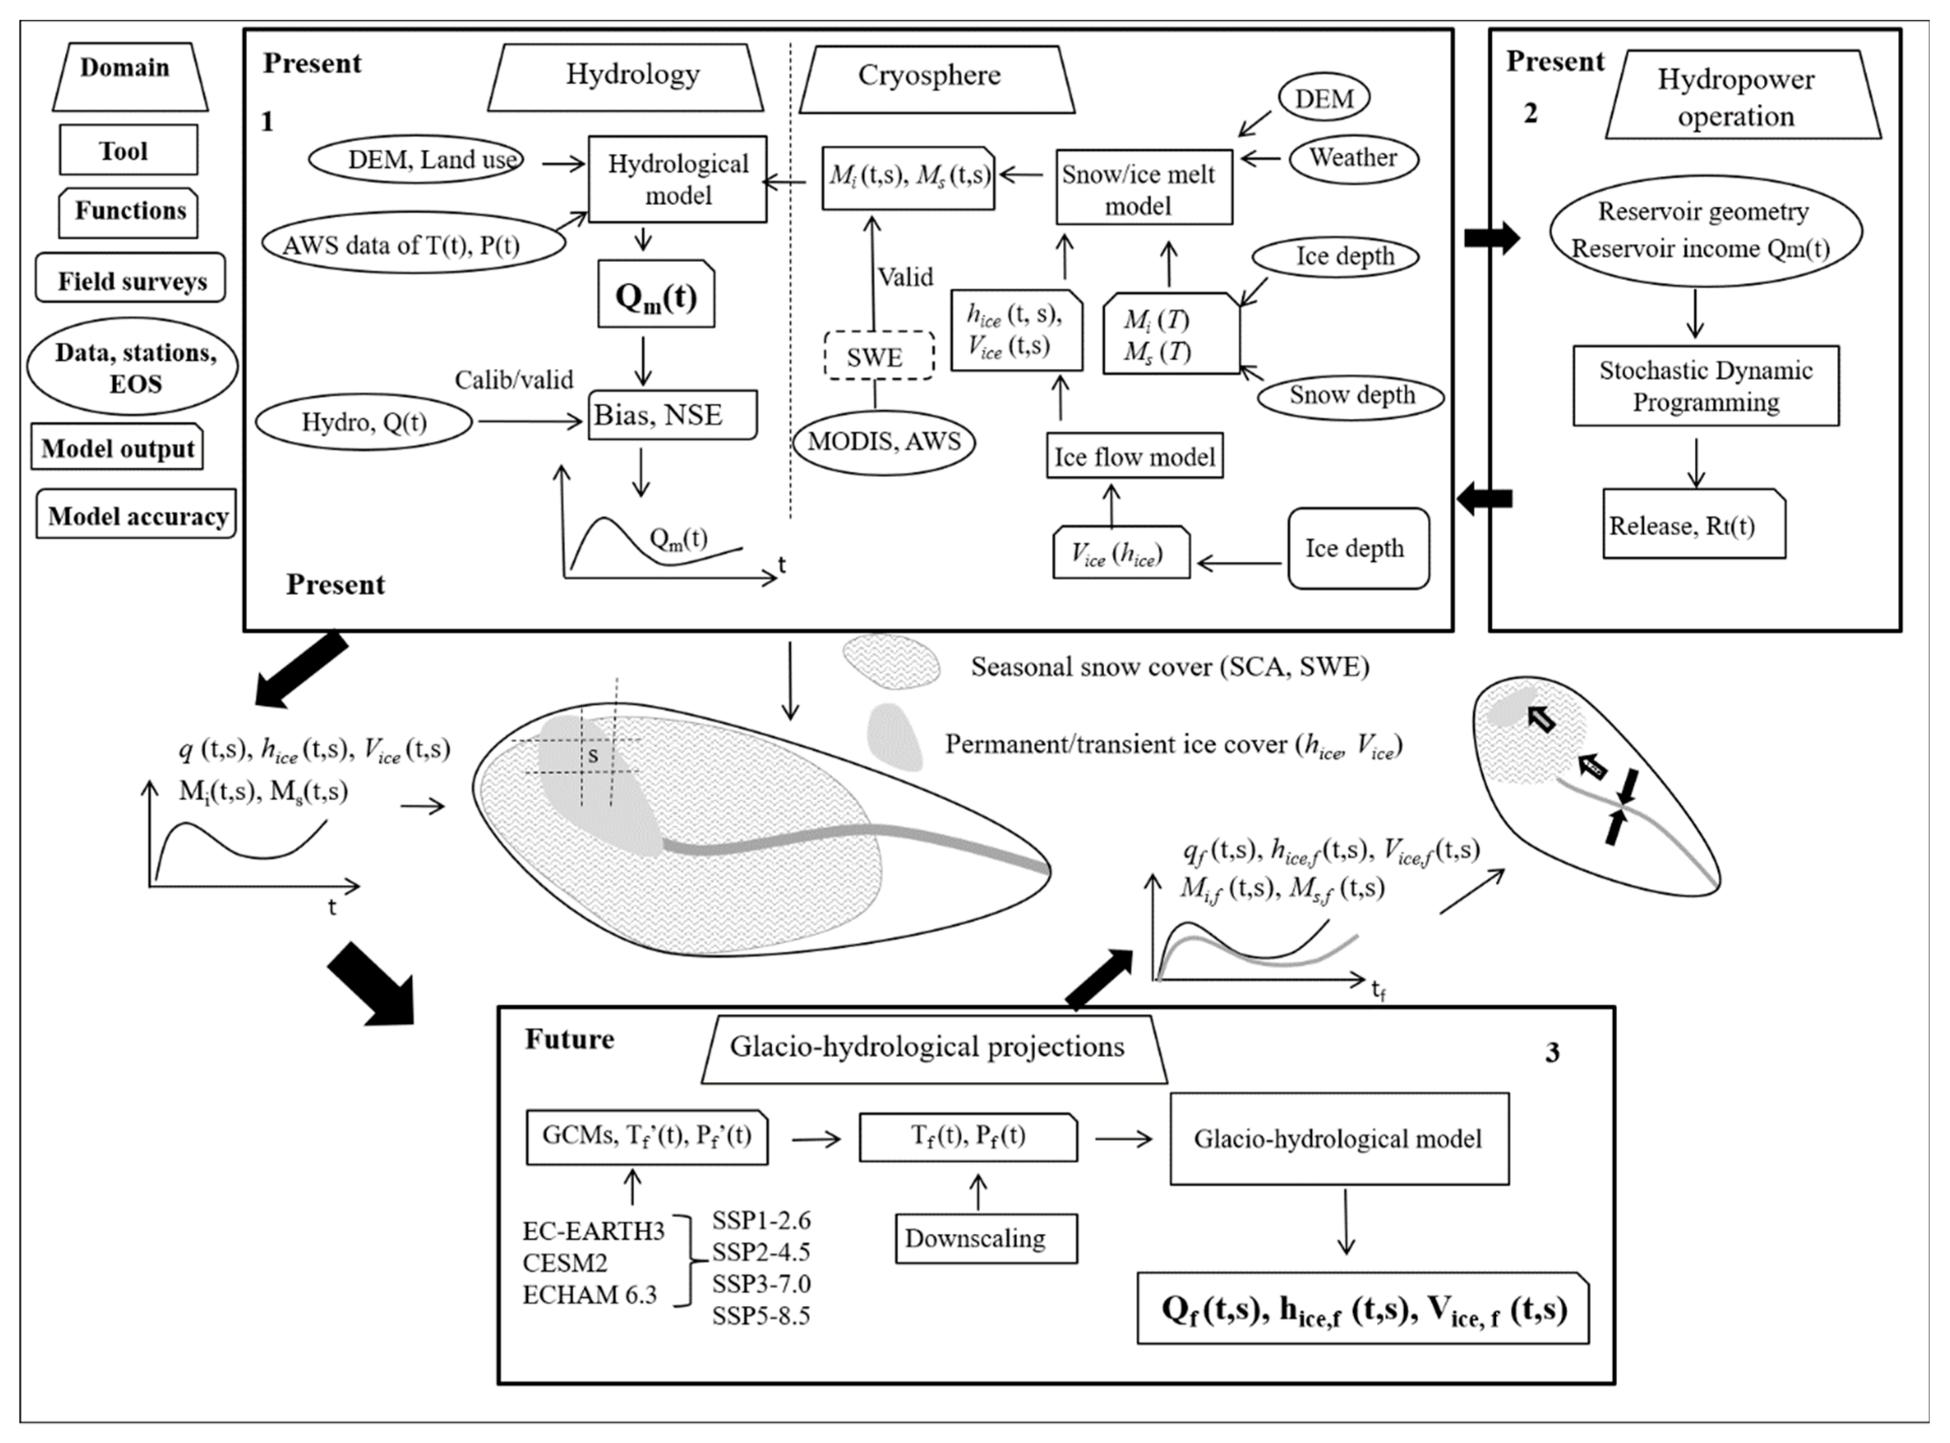
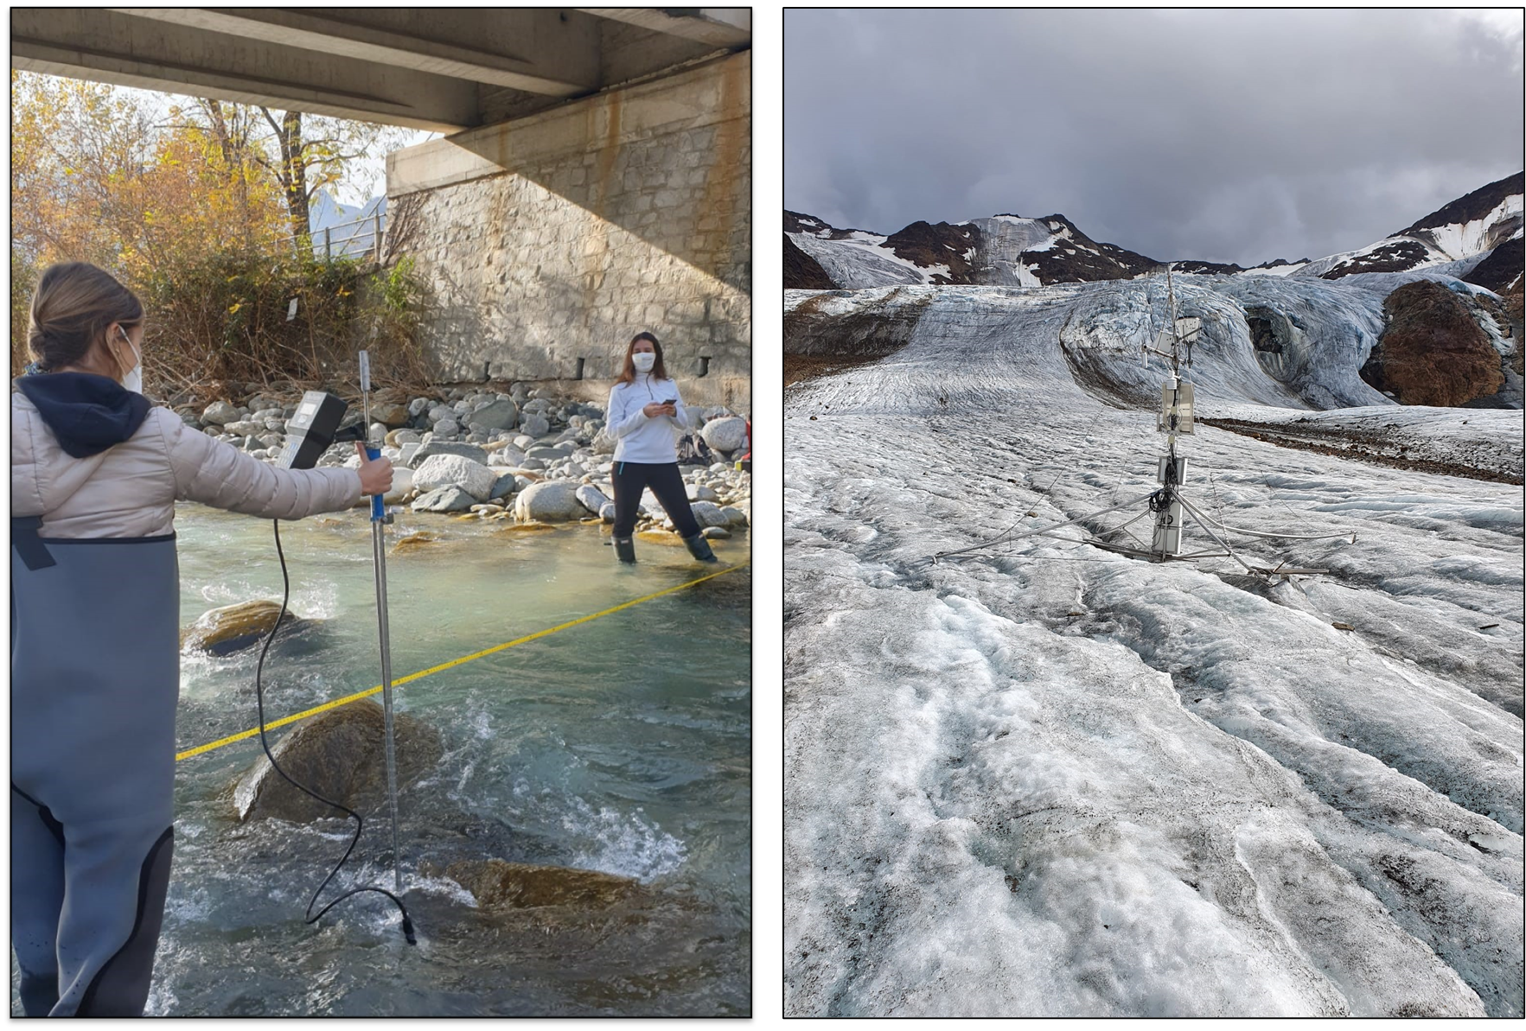
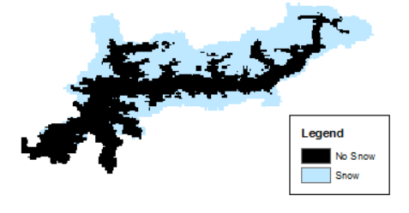
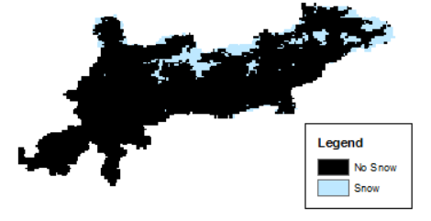
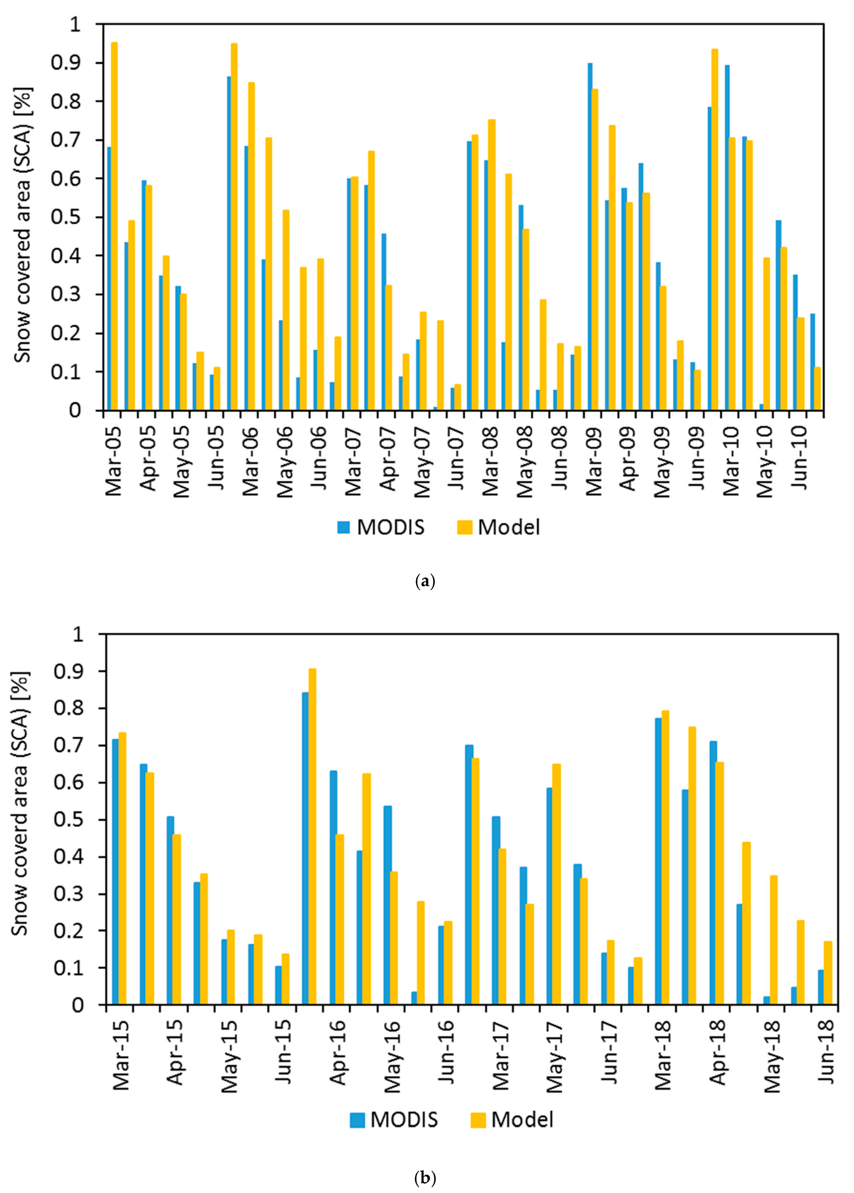
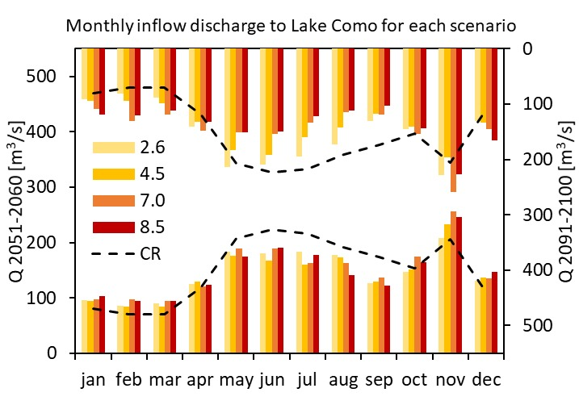
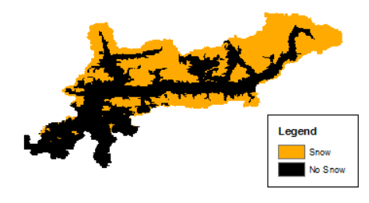
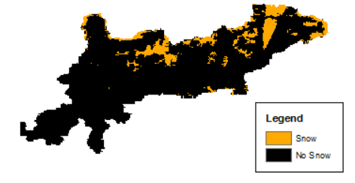
Remote sensing for the future: use of snow cover images to predict hydrology of mountain areas under climate change. The case study of the Lake Como catchment
Remote sensing is crucial for basin wide validation of hydrological models, since it provides precious information on the dynamics of the cryosphere in mountains remote assessment of snow covered areas. This is very useful to tune models, and to subsequently create future scenarios for water resources management under climate change. Here, we present an assassment of the climate change impacts on the hydrology of Lake Como catchment, but this methodology can be applied to other case studies, such as for large lakes with multipurpose management in northern Italy, and in worldwide mountain areas.
Fuso Flavia¹, Casale Francesca¹, Giudici Federico², Bocchiola Daniele¹
1. Department of Civil and Enviromental Engineering (DICA ) Politecnico di Milano, 20133 Milano, Italy
2. Sustainable Development and Energy Sources Department, Ricerca sul Sistema Energetico, 20133 Milano, Italy
Study area:
Lake Como is the third largest lake of Italy with an estimated volume of 23.4 km³. Its contributing catchment has an area of 4438 km² divided between Lombardy (Italy) and the Canton of Grison (Switzerland) and covers a pre-alpine and an alpine territory. The 2.7% of the area is covered by glaciers (i.e., 118 km²). Lake Como is regulated to supply water downstream to irrigated agriculture and to power plants, and to avoid floods on the lake shores. Due to global warming in the last years, the regulation was subjected to conflictive interests of different stakeholders. The Lake Como catchment is strongly exploited for the hydroelectric energy production.
Satellite images:
Snow cover area satellite images (MODIS Terra-snow) are used to calibrate and validate the hydrological model. The correct spatialization of the snow cover area is verified comparing the simulation with satellite images. This guarantees a better performance of the model in the simulation of snow dynamics, and let to more reliable projections of the future scenarios under climate change effects. This study is preparatory for an Interreg IT-CH project, GE.RI.KO. Mera, which goal is to define an effective plan for the management of landslide events, diffuse erosion and solid transport in the Mera watershed, between Italy and Switzerland. The hydrological model is used to simulate the potential erosion in Valchiavenna, and as consequence the solid transport in the Mera river. The snow cover dynamics knowledge is essential for the simulation of the soil erosion using the DRUSLE method.
Poli-Hydro model:
Semi-distributed hydrological model, based on the mass conservation equation of the water soil content between two subsequent temporal steps
S_{t+1}=S_{t}+M_{s}+M_{i}+R-ET-Q_{s}-Q_{g}
Snow and ice melting is simulated using a thermal time accumulation approach and a melt factor [mm/°C/d]:
M_{s,i}=DD_{s,i}(T-T₀)
The Poli-Hydro model uses satellite maps also for the definition of the land cover map (Corine Land Cover maps) and the S_{max} value, and to create the glaciers mask (GLIMS - Global Land Ice Measurements from Space) to simulate the ice melting and the glaciers dynamics.
After the model calibration for the control run period 2002-2018, the model is used to simulate future projections of inflow discharge to Lake Como. 3 GCMs and 4 SSPs of the IPCC AR6 are considered for the simulation.
Data campaigns:
For the calibration of the simulated discharge, data of the Consorzio dell’Adda are used, at the closure sections of Fuentes and Samolaco. Moreover the model is calibrated at the inlet section of Lake Como.
The working group installed an additional station in Chiavenna for the monitoring of discharge and solid transport for the GE.RI.KO Mera project.
Along the Adda river and watershed, some stations are installed and managed for the monitoring of discharge and of meteorological variables (temperature, radiation, precipitation, snow depth).
Modis image 15/03/2008
Modis image 17/06/2008
Modelled SWE 15/03/2008
Modelled SWE 17/06/2008
Model calibration:
Comparison of simulated and observed inflow discharge to Lake Como for the control run period 2002-2018. Inflow discharge are calculated using the inverse flow routing from data of Lake Como level and outflow discharge.
Model validation using satellite derived Snow Covered Areas:
To calibrate the snow accumulation and the snow melting simulated by Poli-Hydro model two kinds of data are used. First, on-site snow depth data from AWS are considered to verify the cumulated SWE (snow water equivalent) [mm].
Then, the model is calibrated and validated comparing the simulated snow cover area (SCA) in different periods during the melting season (March-July) with the NASA satellite images MODIS SCA. The comparison is carried out every two weeks. For the calibration is considered the period since 2005 to 2010, while for validation the period since 2015 to 2018. The relationship between the simulated SCA and the observed SCA reaches an R²=0.73 in the calibration period and an R²=0.78 in the validation period.
Future projections – Climate change scenarios:
Future projections show generally an increase of discharge in autumn and winter (November-March) and a reduction in spring and summer (May-September). This is due to the increase of temperature with an increase of liquid precipitation instead of solid precipitation in winter (especially at low altitudes) and an anticipation of the snow melt peak at the beginning of spring. Possible consequences are the increase of flood hazard in the winter period and a scarcity of water availability in summer. A new regulation of Lake Como is essential to satisfy stakeholders requests.
Bias | 2.15%
Monthly NSE | 0.77
Daily NSE | 0.64

